Slide 1
Fundamentals of DATA analytics WITH TABLEAU
PROJECT TITLE
INDIA’S AGRICULTURED CROP PRODUCTION ANALYSIS (1997 – 2021)

Slide 2

Project Title
India’s Agricultured Crop Production Analysis(1997-2021)
This is a group project. We have include four members on this project. Namely,
I am the TEAM LEAD : PRIYADHARSHINI A, TEAM PERSONS ARE AS FOLLOWS:
Team NM ID :NM2023TMID28768
IIIrd B.Sc.Mathematics
S.NO | REG NUMBER | NAME | NM ID
1 | 31521U25004 | PRIYADHARSHINI A | 1CCED1CB7CB765291FF4F5335C6265FB
2 | 31521U25003 | PABITHA V | 24877B43F288408AD4640D9CBEB34713
3 | 31521U25006 | SAMITHA R | AF62C5A96EB4B59BECC47268C51BF281
4 | 31521U25001 | KAVIPRIYA K | EDC5C9F9A38A7B18ECA45935F4794F1D
Under The Guidance of
D.TAMILSELVAN M.Sc., M.phil.,
ASSISTANT PROFESSOR PG & RESEARCH DEPARTMENT OF MATHEMATICS,
K.M.G COLLEGE OF ARTS AND SCIENCE,
GUDIYATTAM-635803.

Slide 3
INTRODUCTION
1. OVERVIEW
According to India is a global agricultural powerhouse. It is the world's largest producer of milk, pulses, and spices, and has the world's largest cattle herd (buffaloes), as well as the largest area under wheat, rice and cotton. It is the second largest producer of rice, wheat, cotton, sugarcane, farmed fish, sheep & goat meat, fruit, vegetables and tea. While agriculture’s share in India’s economy has progressively declined to less than 15% due to the high growth rates of the industrial and services sectors, the sector’s importance in India’s economic and social fabric goes well beyond this indicator.

Slide 4
2.PURPOSE
Let us analyze the Indian Agriculture crop production for the data collected from 1997 to 2022.
Let us ask interesting questions on existing data, get production and area statistics and understand more on the Indian Agriculture history for crop production.

Slide 5
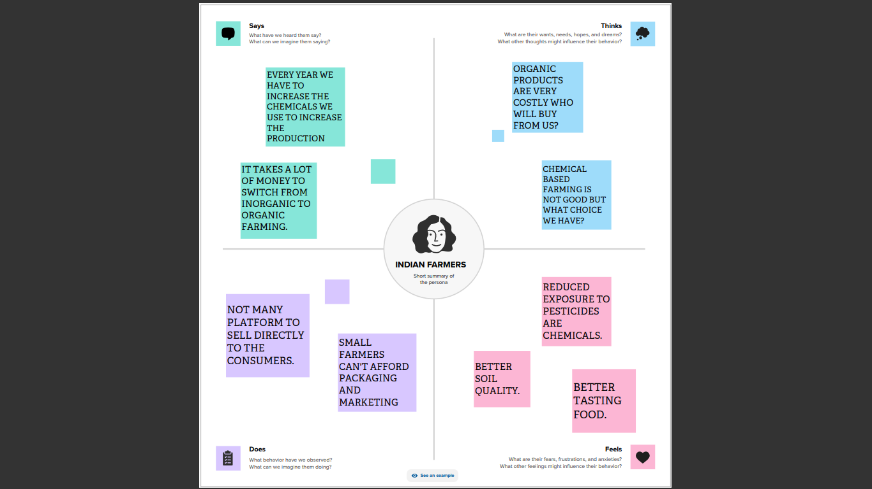
PROBLEM DEFINING & DESIGN THINKING 2.1 Empathy Map

Slide 6
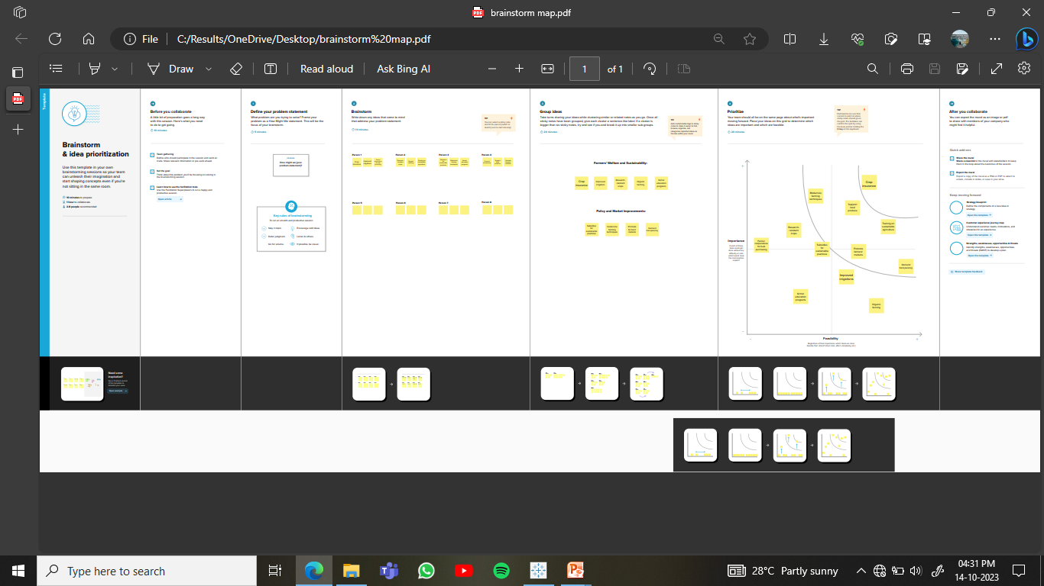
2.2 Ideation & Brainstorming Map

Slide 7
3.result
Final findings (output) of the project

Slide 8
DASHBOARD

Slide 9
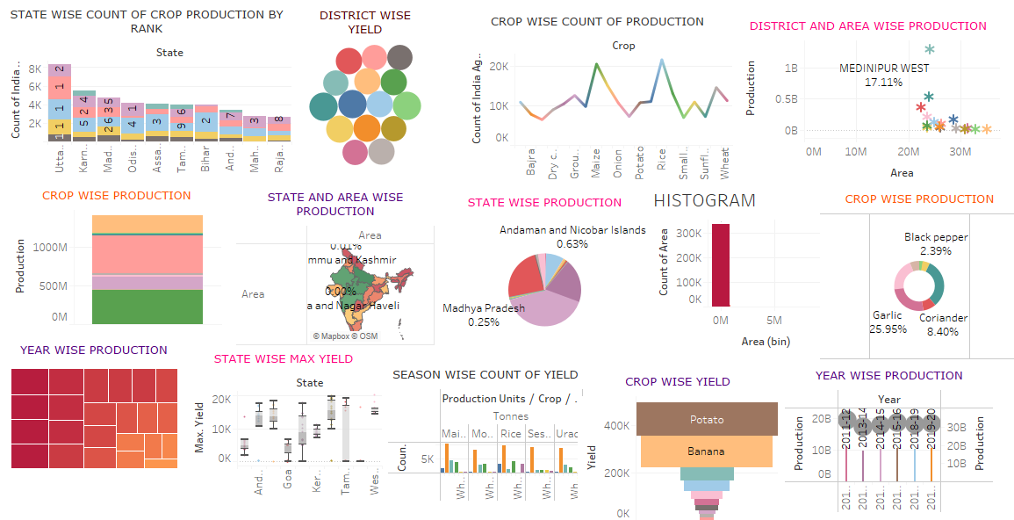

Slide 10
WORKSHEETS

Slide 11
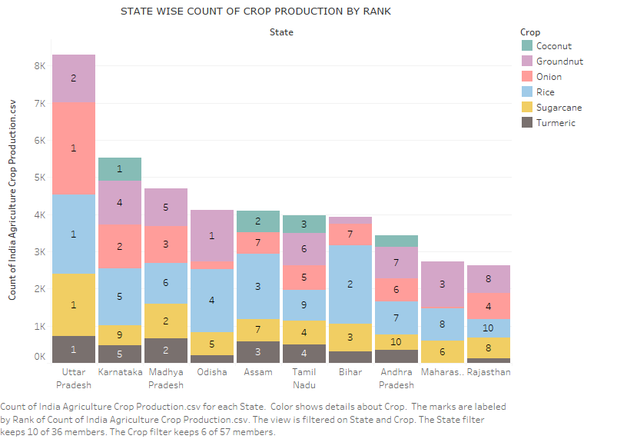

Slide 12
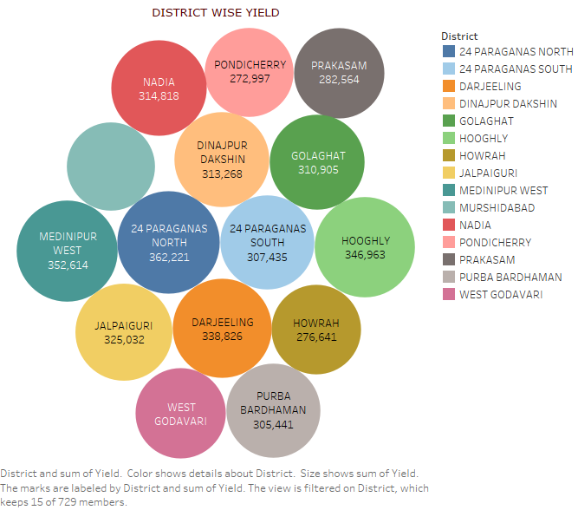

Slide 13
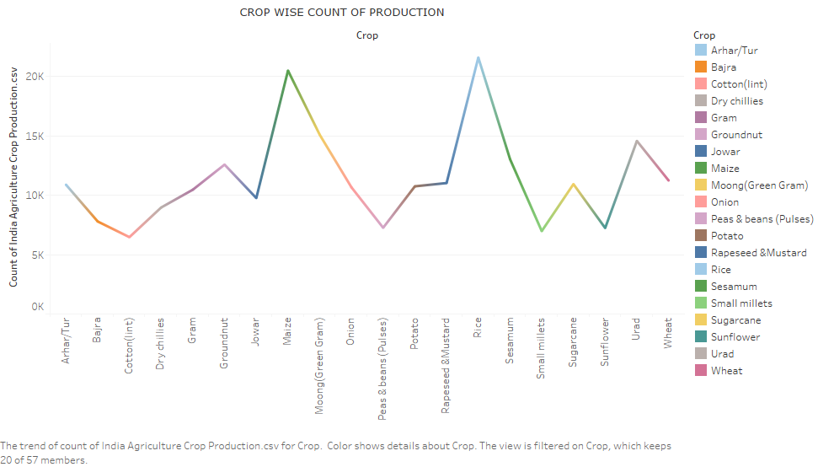

Slide 14
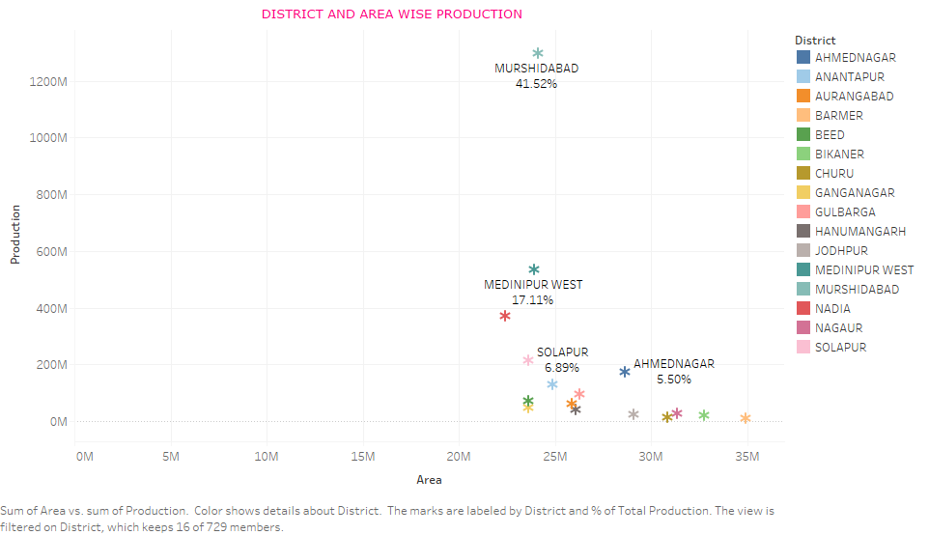

Slide 15
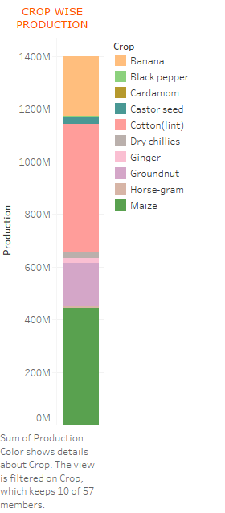

Slide 16
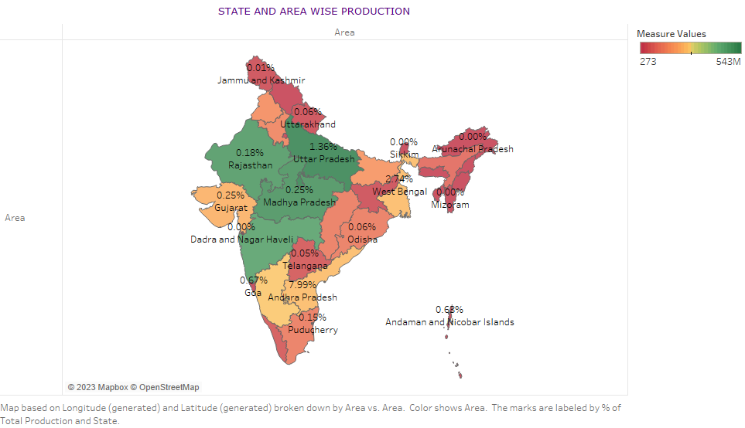

Slide 17
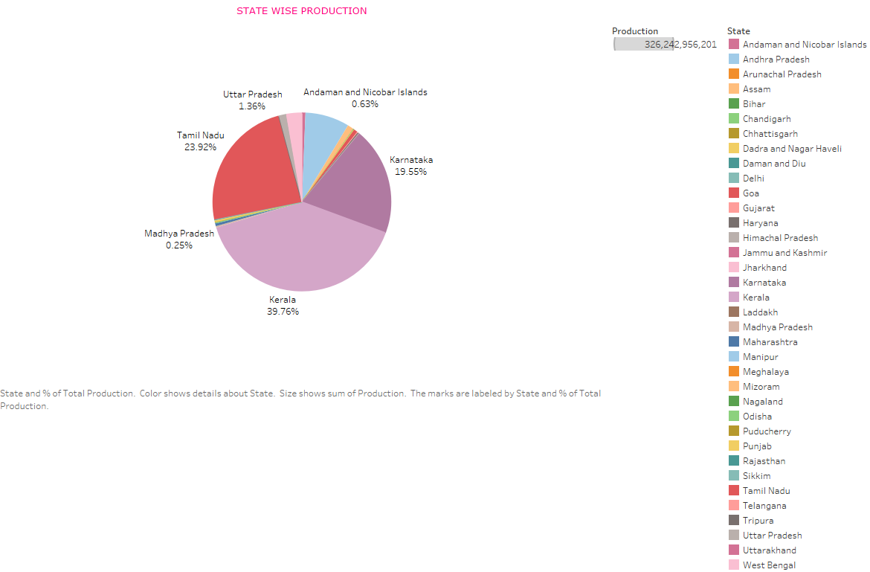

Slide 18
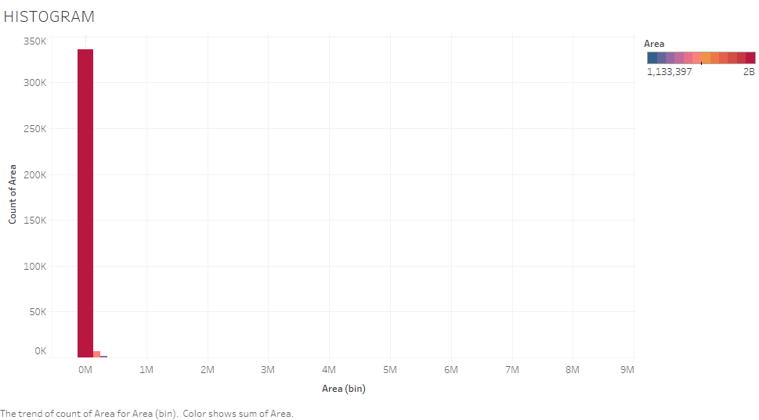

Slide 19
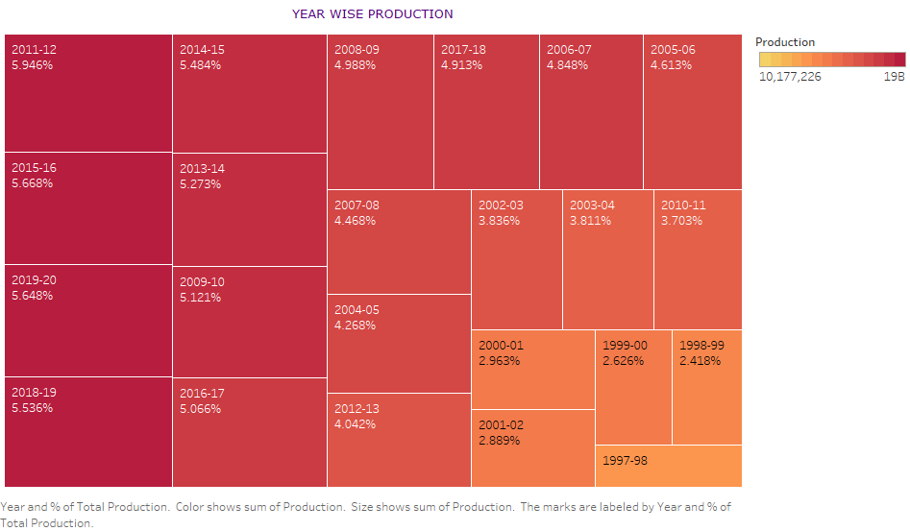

Slide 20
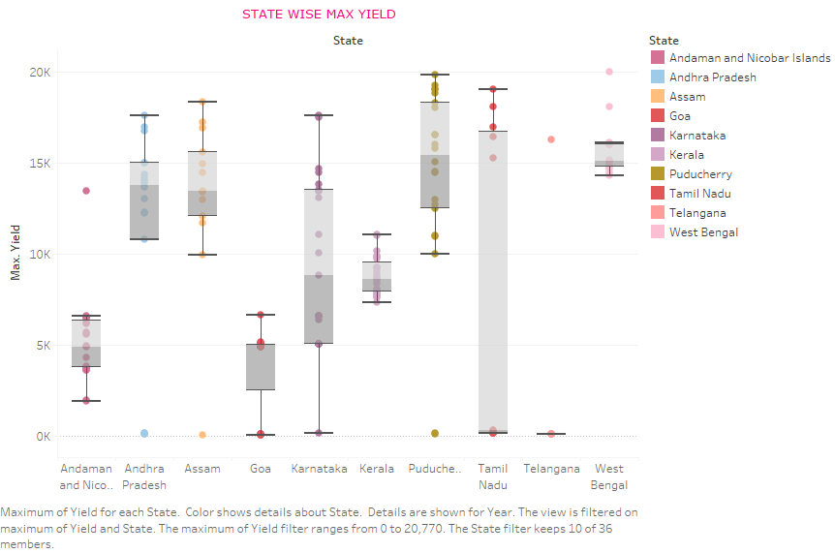

Slide 21
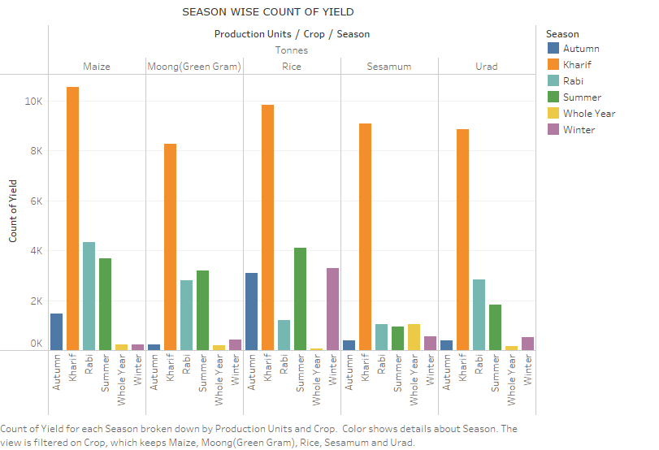

Slide 22
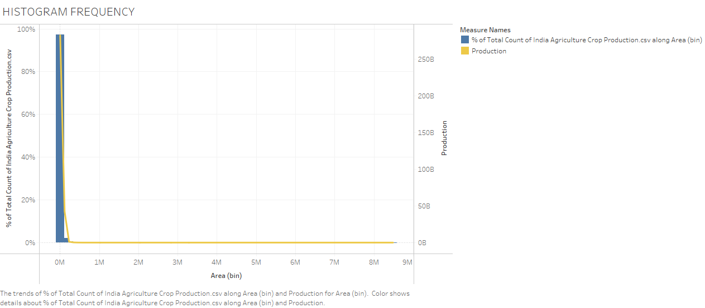

Slide 23
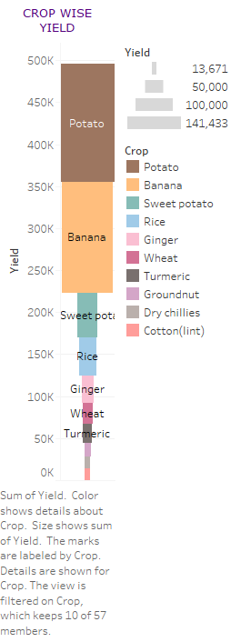

Slide 24
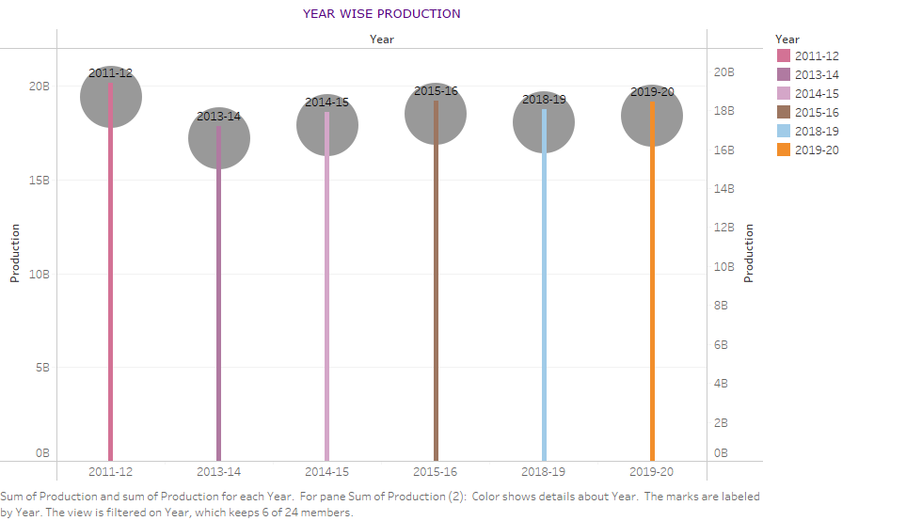

Slide 25
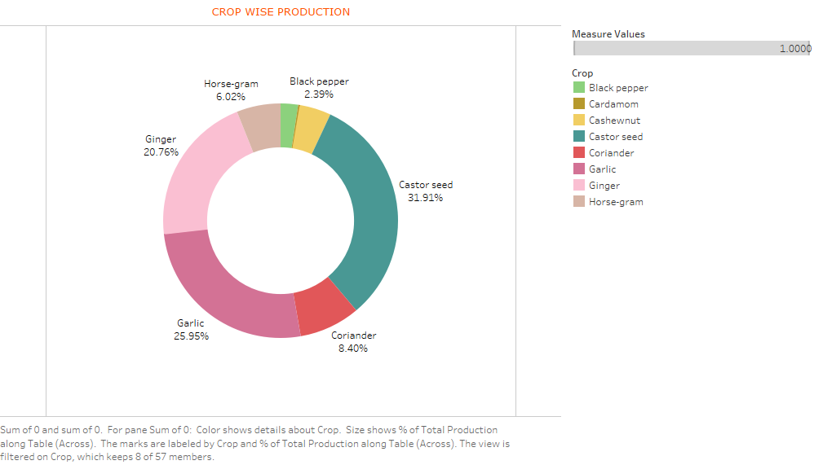

Slide 26
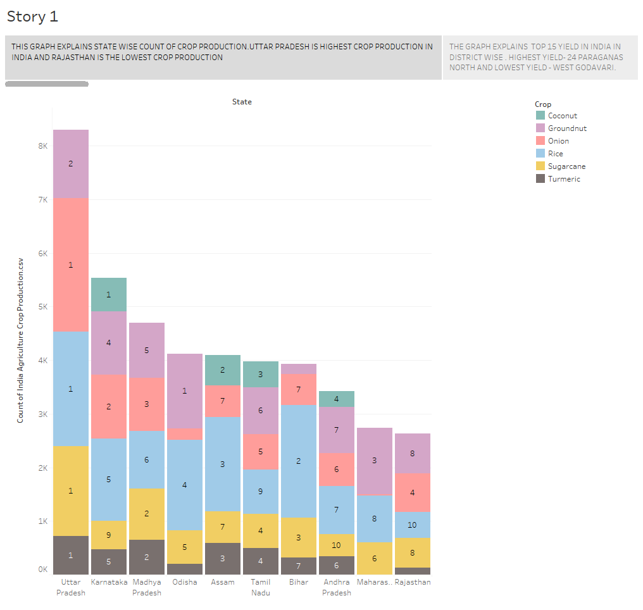
INDIA’S AGRICULTURED CROP PRODUCTION ANALYSIS (1997-2021)

Slide 27
STORY

Slide 28
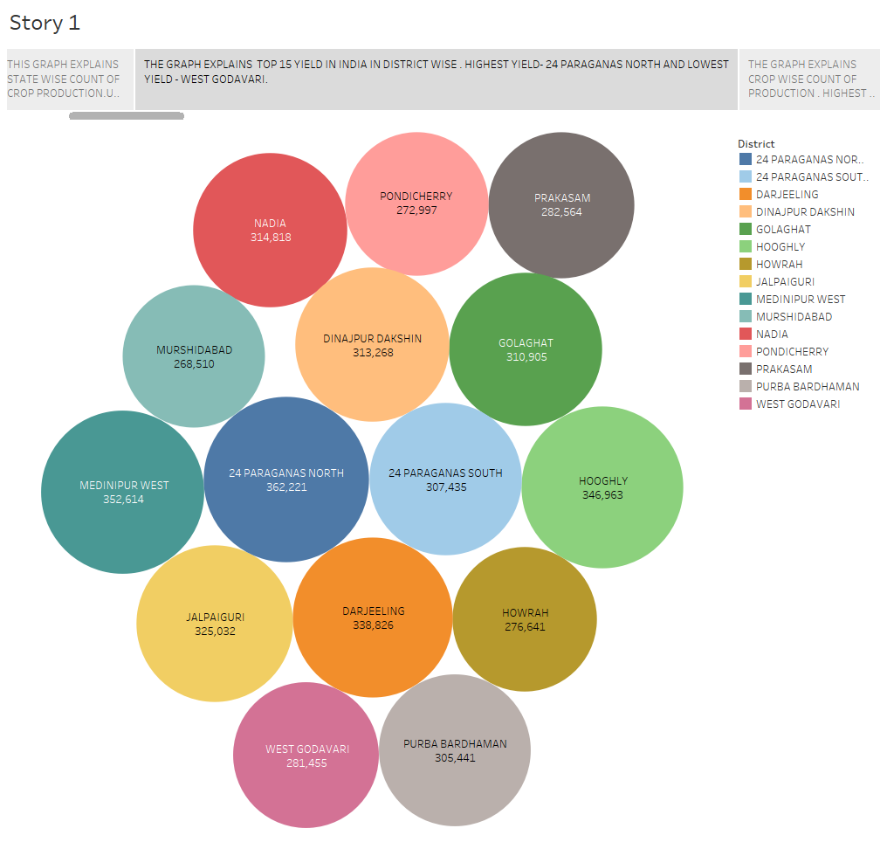

Slide 29
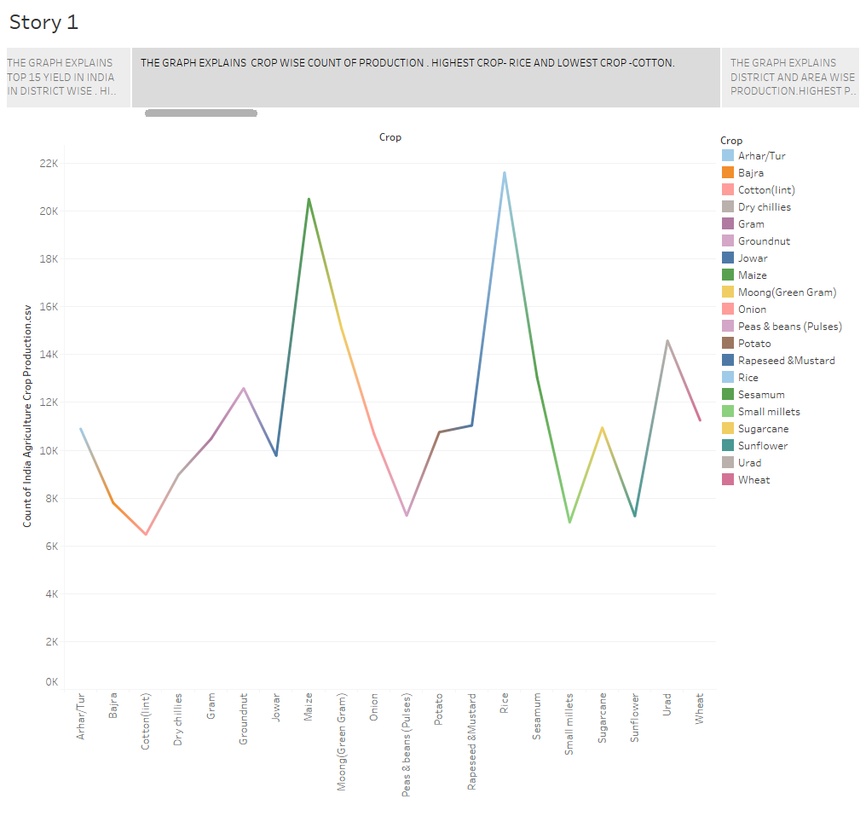

Slide 30
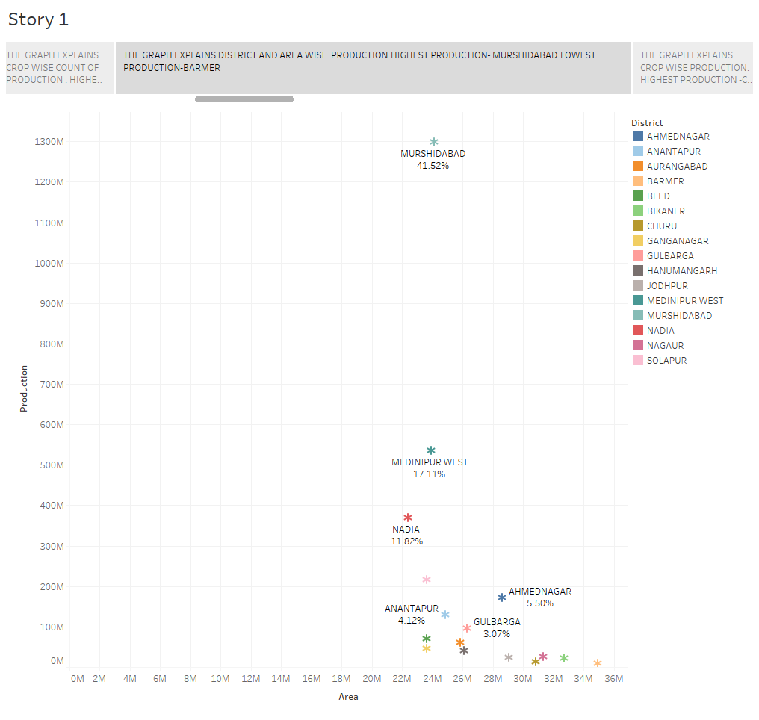

Slide 31
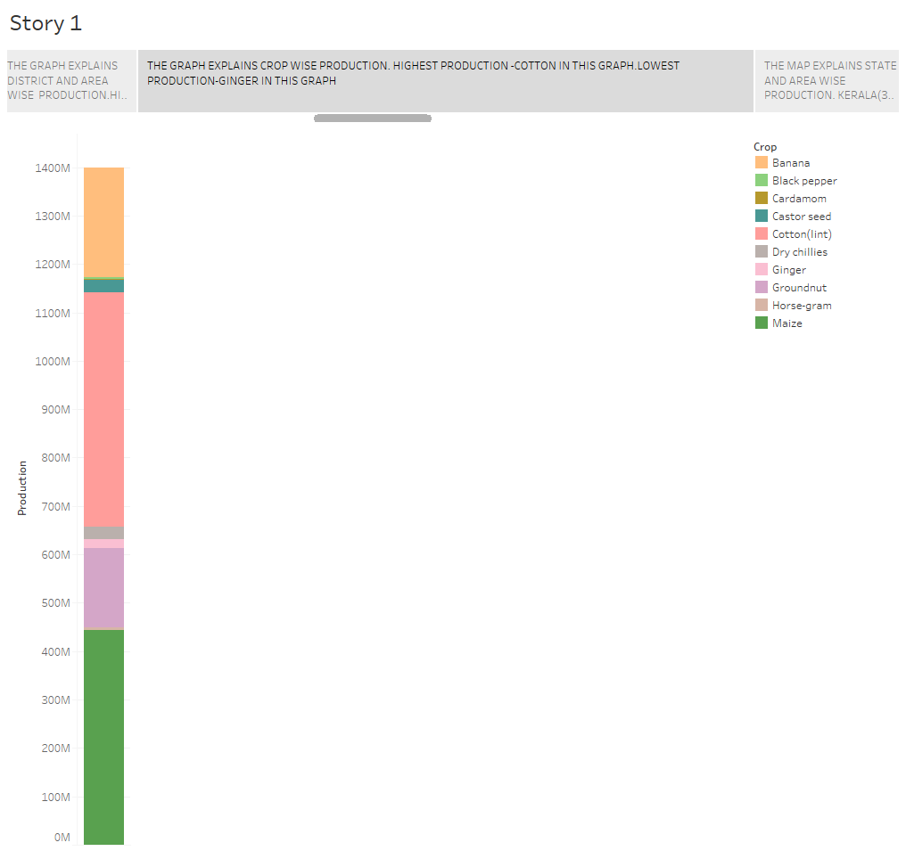

Slide 32
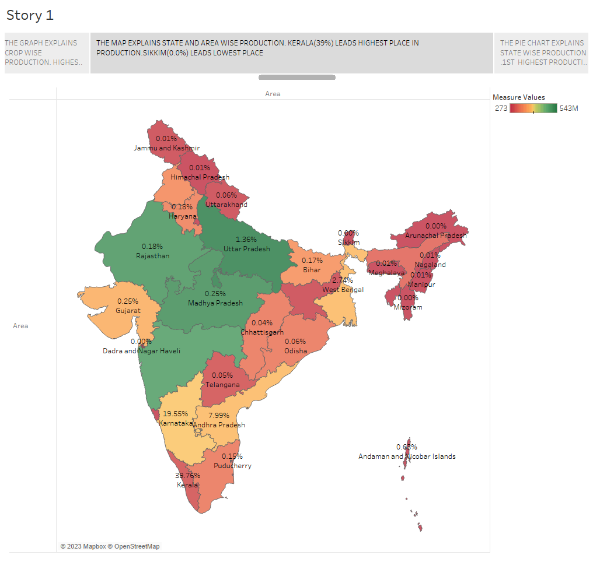

Slide 33
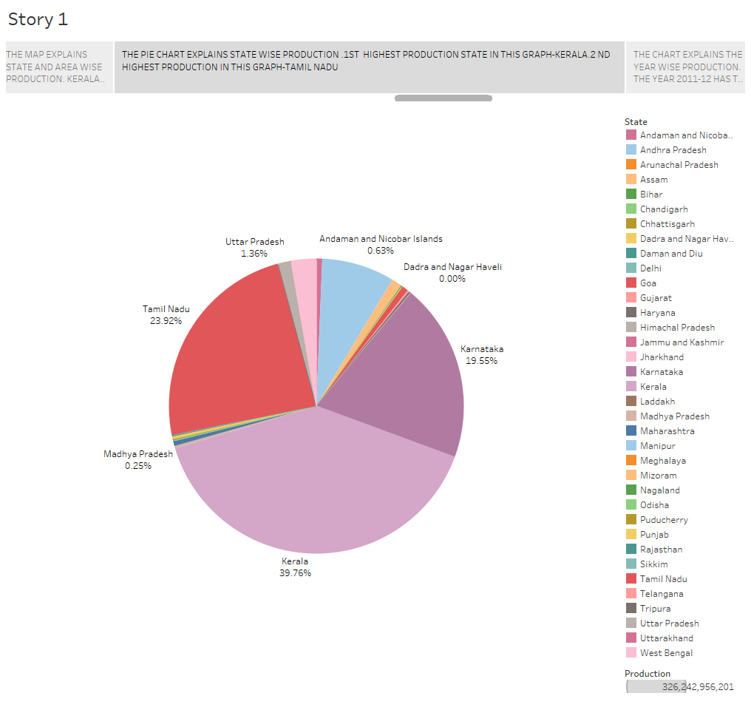

Slide 34
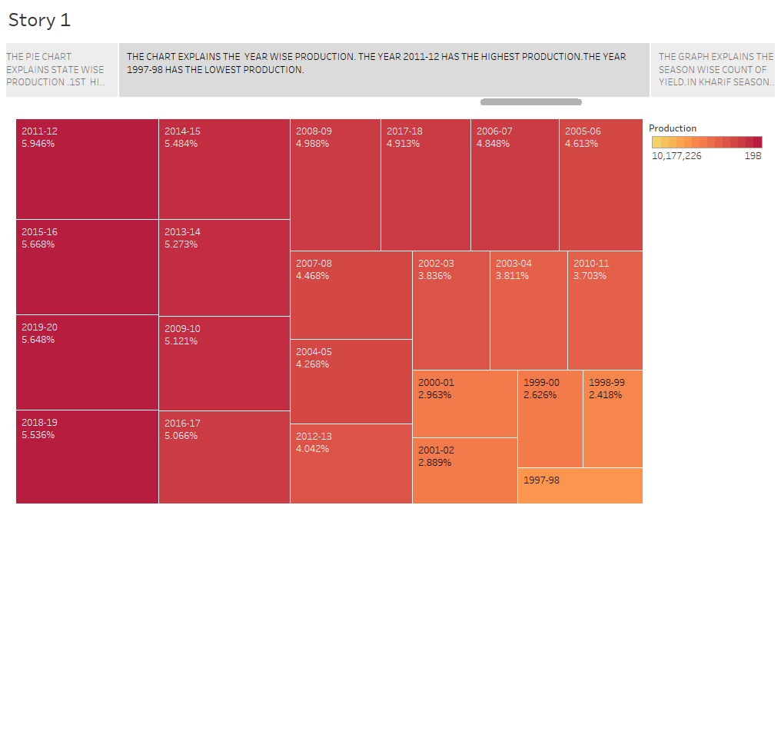

Slide 35
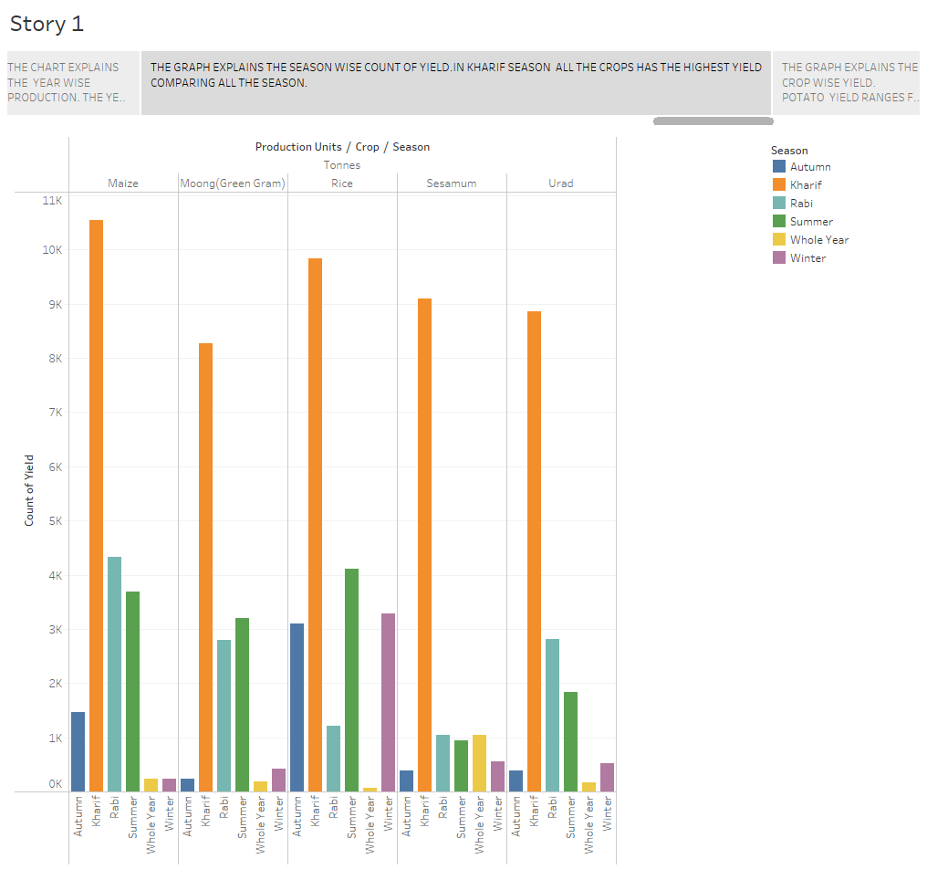

Slide 36
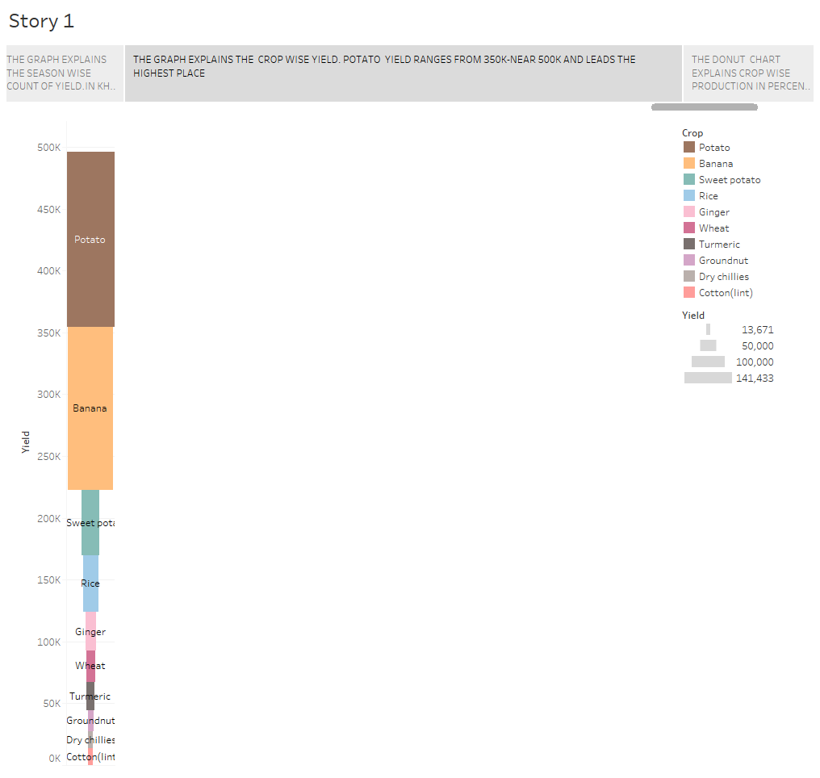

Slide 37
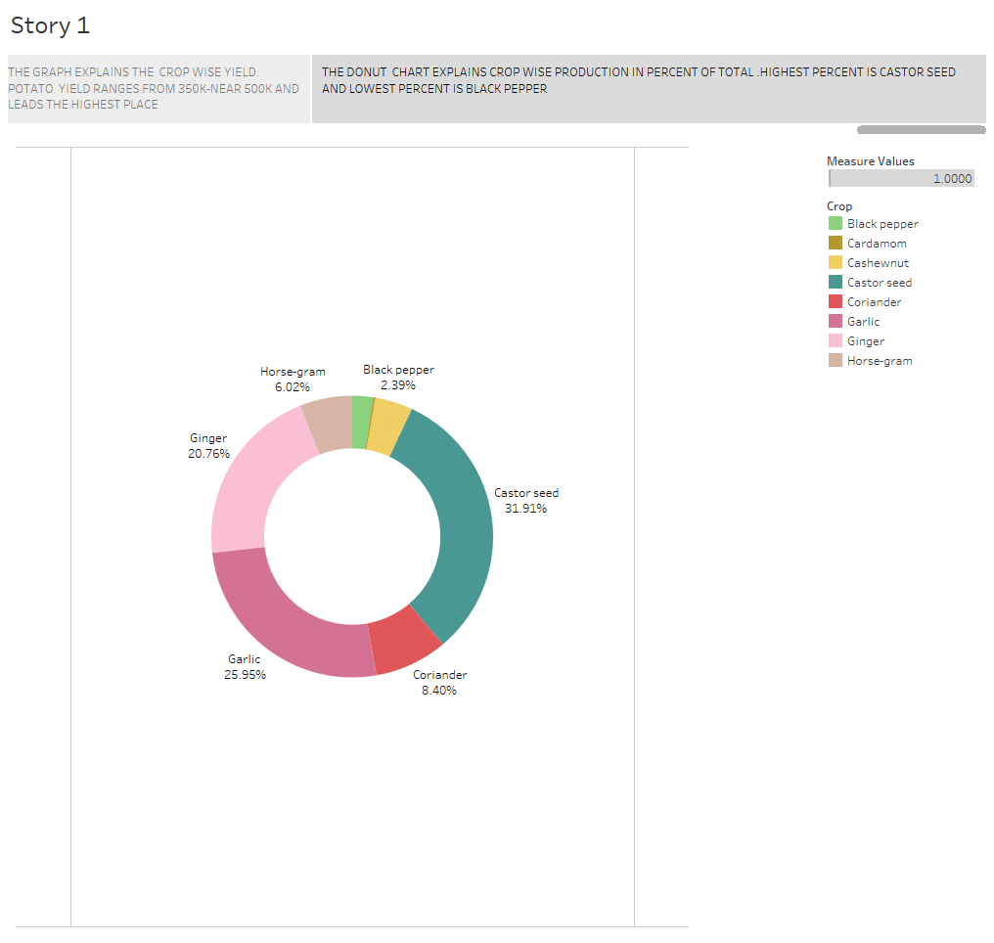

Slide 38
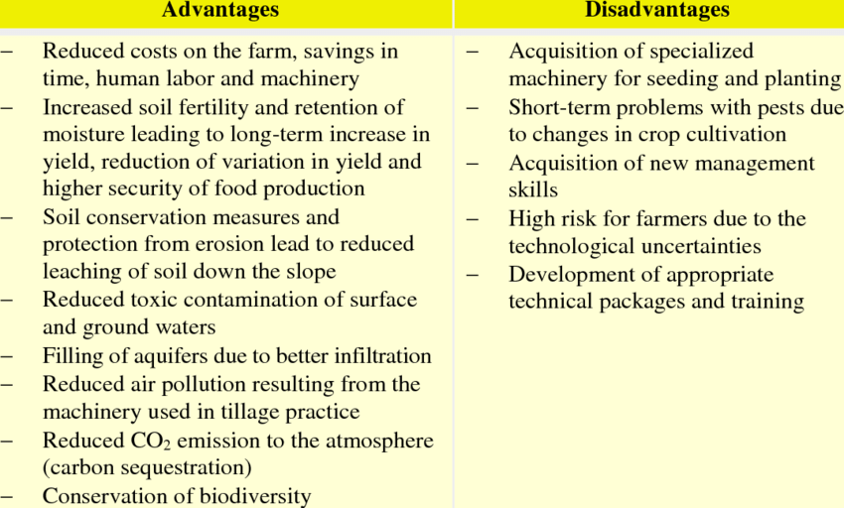
4.ADVANTAGES & DISADVANTAGES :

Slide 39
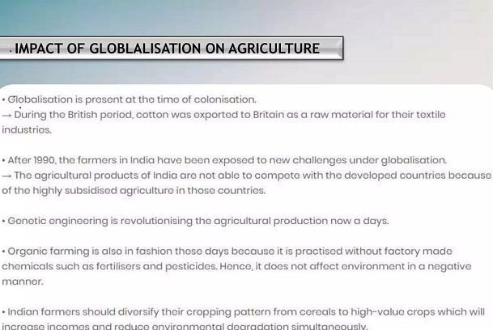

Slide 40
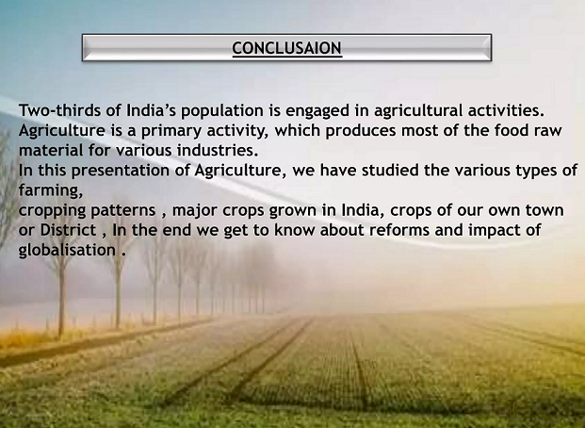

Slide 41
DASHBOARD LINK
https://public.tableau.com/views/dashboard_16973451885170/Dashboard1?:language=en-US&publish=yes&:display_count=n&:origin=viz_share_link
STORY LINK
https://public.tableau.com/views/story_16973455399180/Story1?:language=en-US&publish=yes&:display_count=n&:origin=viz_share_link

Slide 42


